Slide 1
Assignment 2.2 Charts
DSC640
Taniya Adhikari

Slide 2
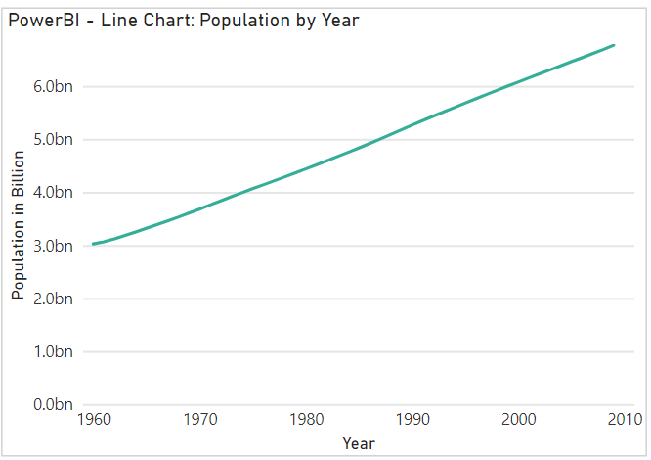
PowerBI – Line Chart

Slide 3
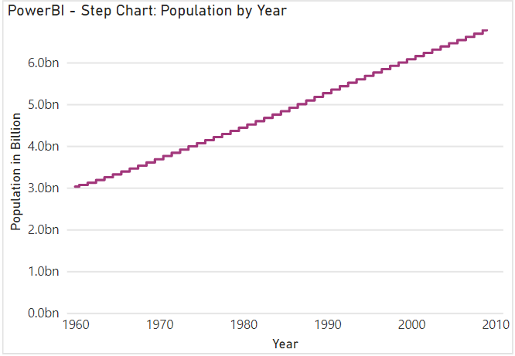
PowerBI – Step Chart

Slide 4
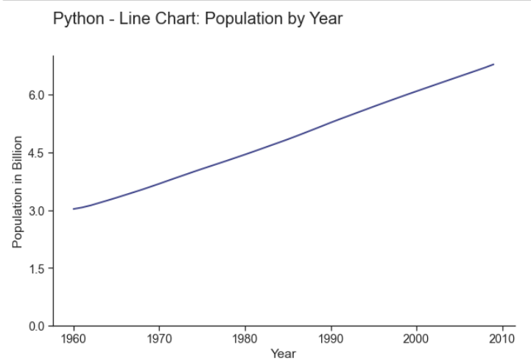
Python – Line Chart

Slide 5
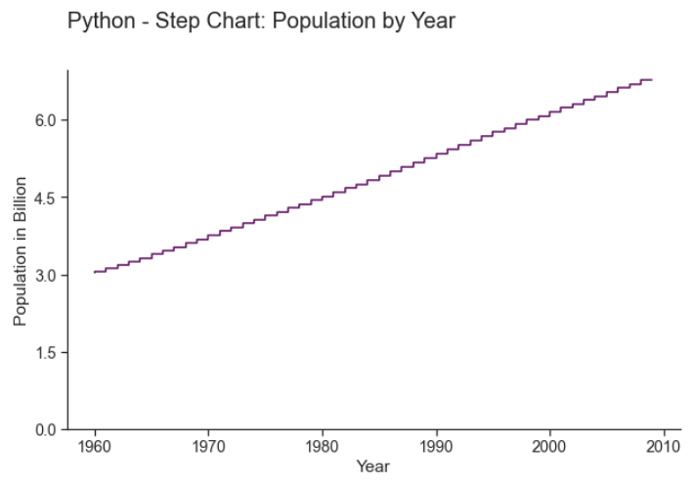
Python – Step Chart

Slide 6
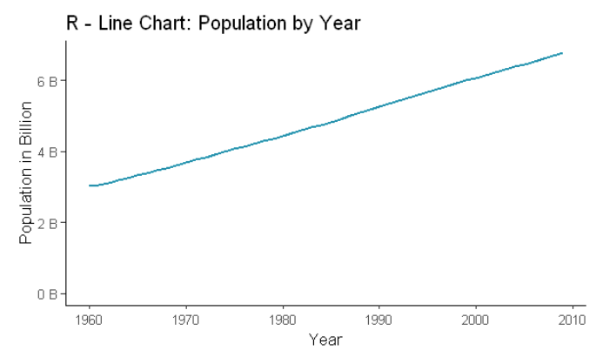
R – Line Chart

Slide 7
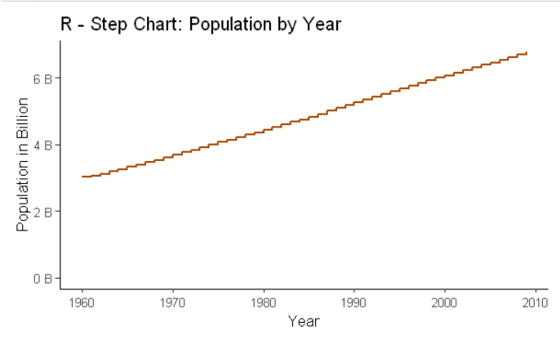
R – Step Chart

Slide 8
Supplemental Files
Python Code
R Code
PowerBI Files

